Slide 1
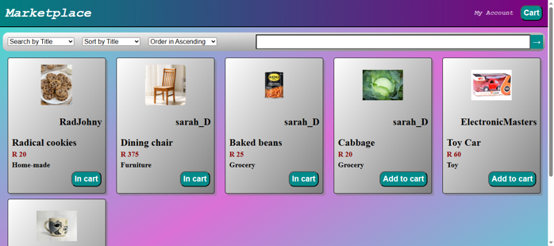
C2C Marketplace for local community members
Keenan Batista – EDUV4845350
ITECA3-12 Web Development
and e-Commerce
Jealous Kamwaya – 29/06/2026

Slide 2
Overview
My project is a C2C e-commerce platform where local community members can purchase items that are listed by other members or small businesses.
This platform is designed to solve the issue of distrust towards online marketplaces by promoting collaboration through communication, in addition to strengthening the local economy where communities can interact with each other.

Slide 3
Functional Requirements
User registration and login.
Update account details.
Create and update listings.
Update and complete deliveries.
Chat with the other user associated with a delivery.
Rate a user after a delivery is completed.
Search for and filter listings as well as users.
Create, update and delete users as well as listings. (Admin management)

Slide 4
Non-functional Requirements
Quick loading time between web pages (< 2 seconds).
Responsive layout design that accommodates desktops, tablets and mobile phones.
Reliable database error detection and rollback.
Reliable input validation.
User friendly interface that indicates input errors.
Scalable for multiple users.
Short toast messages that indicate successful or unsuccessful interactions.

Slide 5
Technologies Used
HTML – Defines the structure of web pages.
CSS – Defines the layout and styling elements of web pages.
JavaScript – Quick input validation and messages.
PHP – Enables for dynamic content on the front-end and processes data as well as validate input.
MySQL – Stores all data relevant of the platform (buyer, vendor, listing, deliveries, etc.).
VS Code – A code editor used to create and test the platform.
XAMPP/Apache – Enables the platform to be hosted locally for testing purposes.
InfinityFree – Enables the platform to be hosted online.
GitHub – Acts as a back up for the platform’s code.

Slide 6
System Architecture
1. User (browser)
2. PHP
4. HTML / CSS / JS
5. PHP
6. MySQL database
3. MySQL database
The user uses a browser to access the platform.
The PHP file defines the dynamic content of a web page after collecting data from the MySQL database.
Relevant data from the MySQL database is retrieved.
The HTML elements are defined after all dynamic content is received. Any CSS and JavaScript elements are established for the web page.
Any back-end processing (collecting data, validating inputs, etc) is performed.
Any data associated with the database tables (buyer, vendor, listings, etc) are stored.

Slide 7
Development Process (SDLC-based)
SDLC Process
Requirement analysis – The scenario was analysed to determine the functional and non-functional requirements.
Design – Dynamic CSS elements are considered to ensure that the platform can scale efficiently and accommodate different screen sizes.
Implementation – VS Code was identified and used to code the functional and non-functional requirements.
Testing and debugging – Placeholder data was used to test the functionality of the platform and any identified issues were debugged.
Challenges and solutions
FlexBox and Grid elements on CSS was used to solve the scalable UI issue.
Different screen sizes were accommodated by changing CSS elements based on the screen size.
The reliability of the platform’s error detection code was a concern and was tested by inputting incomplete and incorrect data.

Slide 8

Key Features Demo

Slide 9
Testing and Security
Testing
All web pages that involve user input were tested with incorrect data to ensure that the platform could identify it.
All web pages with a MySQL database connection were tested with incorrect SQL statements to determine if the platform could identify it and rollback all database changes.
Issues Identified
Unclear error messages due to input validation.
Pressing the back button to access a web page that shouldn’t be available after logging out of an account.
Security
Input validation to prevent cross-site scripting attacks.
Sessions are used after the user logs in.
Passwords are hashed.
Database rollbacks are performed to prevent incomplete data changes from being stored in the database.
Solutions
Specific error messages.
Redirect to the main page if not logged into an account.

Slide 10
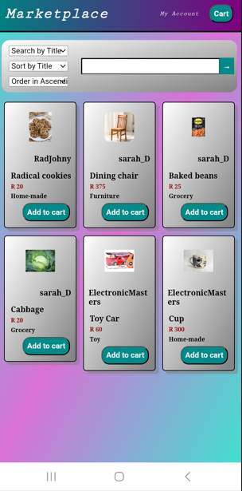
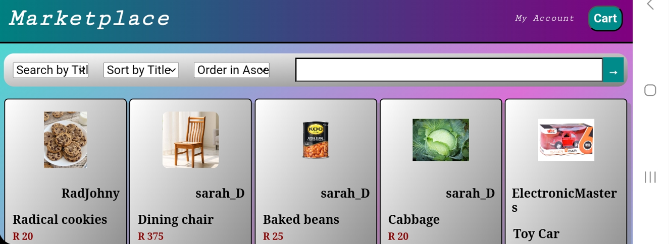
User Friendliness and UI Design
JavaScript was utilised to provide appropriate messages under input fields if data was missing or incorrect.
Listings are organised in a grid layout where the length of the layout changes depending on the screen size.
The size and layout of CSS elements are changed based on the screen size to ensure that information remains readable despite the screen size.
Mobile display:

Slide 11
Reflections and Lessons Learned
Improved skills
Improved CSS skills with regards to layouts and accommodating different screen sizes.
Improved data validation when processing data in PHP.
Improved MySQL database error detection and remediation.
Biggest challenge
Determining how to revert all changes made to the MySQL database if an error occurs before all possible database changes are performed in the code.
Solution
Utilising a transaction and a try catch block where any errors that are detected will perform a rollback on all changes made to the database and if no errors are detected then all changes are committed.
Overall lesson
How each file type (HTML, PHP, CSS, JS) can be utilised in conjunction with each other to enable complex, dynamic features as well as user-friendly UI features and characteristics.

Slide 12
Conclusion
This platform has alleviated the distrust that surrounds online marketplace platforms through collaboration and communication features between users, security mechanisms for sensitive data as well as reliability with input validation. Additionally, it can assist in strengthening the local economy by providing a new method for small businesses to branch outside their local community.
This project demonstrates my ability to create a functioning C2C e-commerce website utilising various web technologies (HTML, PHP, CSS, etc.) with basic e-commerce features (create listings, purchasing deliveries) and new features (chat functionality) that compliment it.

